Slide 1
Water
Dr. Druman Ramesh Utekar

Slide 2
Sources and Impurities in Water
Sources
Impurities
i) Physical Impurities
ii) Chemical Impurities iii) Biological Impurities

Slide 3
Acidity in water
H₂O + CO₂ → H₂CO₃
_{Hardness of Water}
Hardness of water is that characteristic which prevents the lathering of Soaps.
_{Or’}
It is the soap consuming capacity of water sample.

Slide 4
Industrial problems of water
Boiler corrosion
Caustic embrittlement
Formation of scale and sludge
Priming and foaming

Slide 5
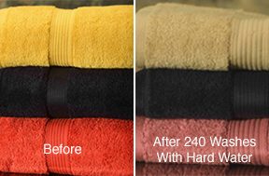
TEXTILE INDUSTRY
Hard water causes much of soap used in washing yarn, fabric etc. to go as waste because hard water cannot produce good quality of lather.
Precipitates of calcium and magnesium soaps adhere to fabrics.
These fabrics when dyed doesn’t produce exact shades of color.
If the water contains Iron, manganese, color or turbidity, it leaves stains on fabrics.
Organic matter imparts foul smell.

Slide 6
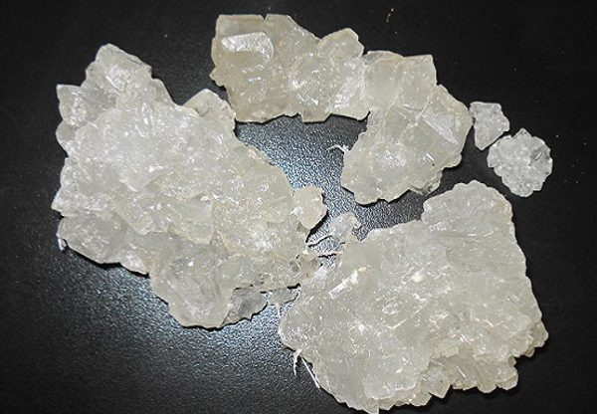
SUGAR INDUSTRY
Water containing sulphates, nitrates, alkali carbonated, etc., if used in sugar refining causes difficulties in the crystallization of sugar.
Moreover, the sugar so produced may be deliquescent.
The color and taste of the sugar also changes.

Slide 7
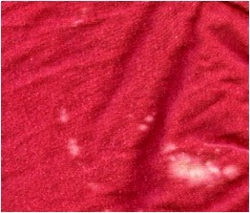
DYEING INDUSTRY
Hard water contains dissolved calcium, magnesium and iron salts. These salts present in hard water may react with costly dyes, forming undesirable precipitates, which yield impure shades.
Uniform dyeing is not possible because
1. Hard water decreases the solubility of dye or color. (PH increases)
2. Basic dyes also precipitate out in hard water. (eg. Ca²⁺ ions react with bicarbonate.
(HCO₃⁻) ions to form insoluble calcium carbonate (CaCO₃))
They also give spots on the fabrics being dyed.

Slide 8

PAPER INDUSTRY
Calcium and magnesium salts present in hard water tend to react with chemicals and other materials employed to provide a smooth and glossy (i.e. shining) finish to paper.
It also produces in the cracks in paper.
Alkalinity (consumes alum and increases the cost of production)
REACTION: Al₂(SO₄)_{3.}14H₂O + 6HCO₃⁻ →2Al(OH)₃ + 6CO₂ + 14H₂O + 3SO₄²⁻
Moreover, iron and manganese salts may even affect the brightness and color of paper being produced.
Calcium and magnesium salts increase the ash content of paper.

Slide 9
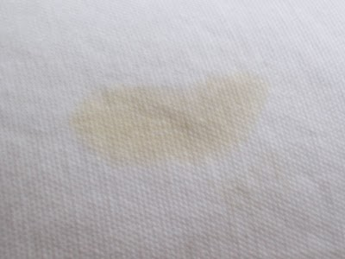
LAUNDRY INDUSTRY
Laundries require soft water, free from color, manganese and iron
Due to hard water, consumption of soaps increases.
Iron and manganese salts impart a grey or yellow shade to the fabric.
Weakening of fibres causing tears and thus shortening the life of the fabric.
Fabrics lose their soft and supple feel to become stiff and harsh.
Extra detergent, extra rinse and wash cycles to clean the laundry.

Slide 10
PHARMACEUTICAL INDUSTRY
Pharmaceutical industries require ultra pure water which should be colorless, odourless, tasteless and free from pathogenic organisms.
Hard water, if used for preparing pharmaceutical products like drugs, injection, ointments, etc. may produce undesirable products in them.
According to the pharmaceutical guidelines stated by
WORLD HEALTH ORGANISTION
If the pharmaceutical manufacturer's water supply is “hard” it needs to be “softened” which increases the cost of production.

Slide 11
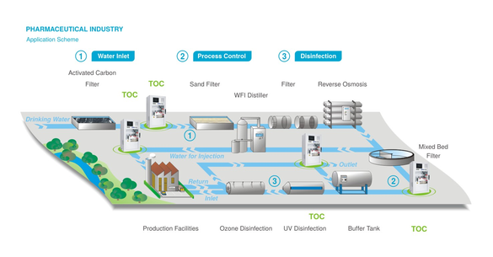

Slide 12
BEVERAGE INDUSTRY
Water used in beverage industries is very sensitive.
Water should be free from any contaminants and micro-organisms.
Water required should not be alkaline, as it destroys or modifies the taste as it tends to neutralize the fruit acids.
If hard water is used in this industry, it can change soft drink color, test and odor. Moreover a deposit can be developed here.
So water must be treated before use for decreasing the effects of hard water in beverages industries. Otherwise it would lessen the product quality.

Slide 13
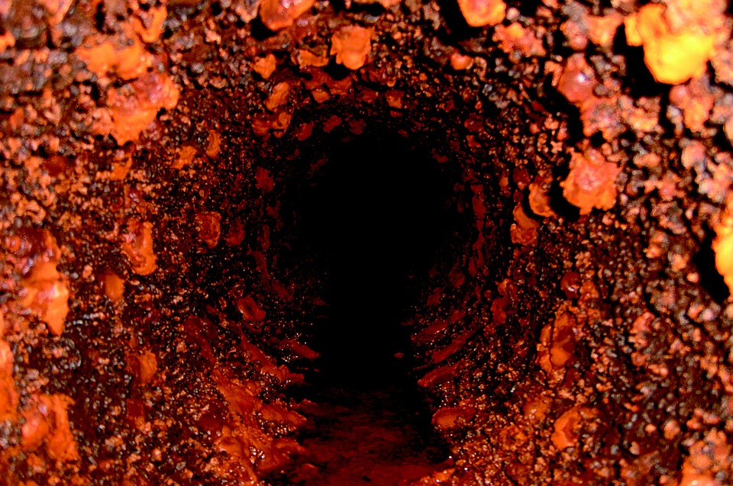
RUST FORMATION
The carbonate hardness salts cause deposition in tubes and pipes:
REACTION: Ca(HCO₃)₂ → CaCO₃ + H₂O + CO₂
The calcium carbonate (CaCO₃) thus formed is responsible for deposition in pipes.
Similarly the CO₂ which is released reacts with water to form carbonic acid which is corrosive and causes severe corrosion in pipes.
This decreases the strength of the material making it unsafe to bear high temperature and pressure.

Slide 14
SLUDGE AND SCALE FORMATION
In boilers, conc. of salts increases due to continuous evaporation of water.
When the conc. reaches saturation point it is thrown out of the water in form of ppt, which gets settled on the inner walls of the boiler.
If the ppt takes place in form of loose and soft ppt it is called as sludge. It is formed at comparatively colder regions of boiler or at bends. Eg. Mg(OH)₂
If the ppt sticks firmly to the inner walls of the boiler it called as scales. Sometimes it is even difficult to remove with hammer or chisel. Eg. MgSiO₃
DISADVANTAGES OF SLUDGE AND SCALE FORMATION
Wastage of fuel
Lowering of boiler safety
Decrease in efficiency
Danger of explosion

Slide 15
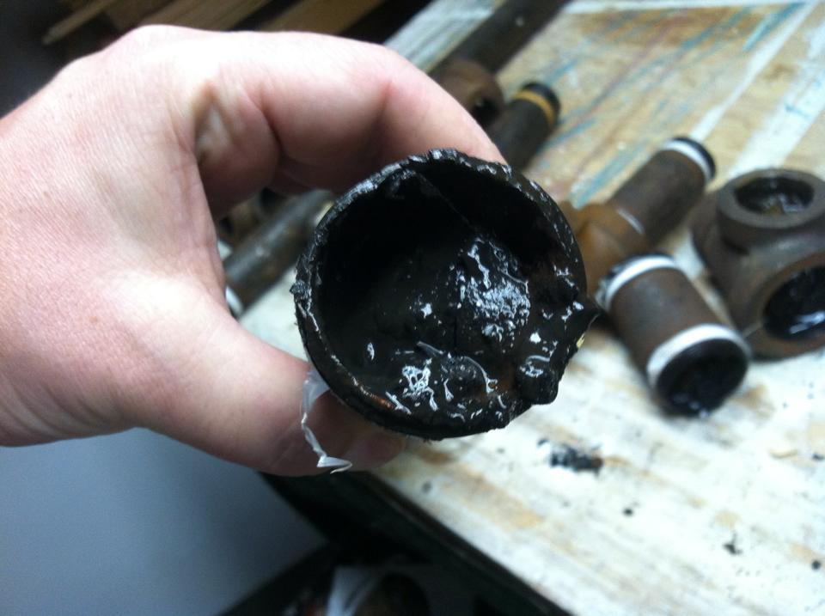
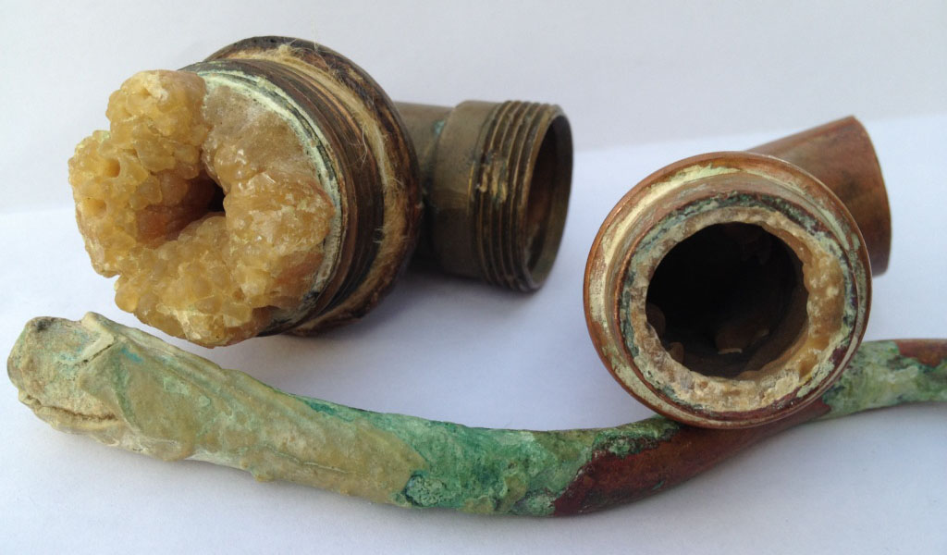
SLUDGE AND SCALE FORMATION
SCALE
SLUDGE

Slide 16
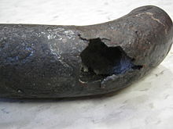
CAUSTIC EMBRITTLEMENT
In a boiler, some qty. of Na₂CO₃ added to soften the water. But since high pressure and high temperature in the boiler converts Na₂CO₃ to NaOH.
REACTION: Na2CO3 + H2O → 2NaOH + CO2
Because of NaOH, boiler water becomes alkaline. This very dilute alkaline water flows through minute hair cracks.
When water evaporates, this dilute alkali becomes concentrated.
This concentrated alkali reacts with iron to form sodium ferroate.
REACTION: 2NaOH + Fe → Na₂FeO₂ + H₂
This sodium ferroate gets deposited in crevies and cracks.
This reaction is reversible i.e. where at high temperature sodium ferroate decomposes to form NaOH and Fe₃O₄ . So reaction continues making use of iron metal of boiler.
REACTION: Na₂FeO₂ + H₂O + O₂ → 12NaOH + 2 Fe₃O₄

Slide 17
REFERENCES
Engineering Chemistry Textbook by Chopra and Parmar
Engineering Chemistry by Pearson
http://textilelearner.blogspot.com/
http://www.environmentalpollution.in/
https://www.chegg.com/homework-help/
http://web.deu.edu.tr/atiksu/ana52/
http://apps.who.int/medicinedocs/

Slide 18
THANK YOU!

Slide 19
Soap and Soap Consuming capacity
Soap is sodium or potassium salt of higher fatty acids like oleic, palmitic or steric acid.
Soap Consuming capacity of water
C₁₇H₃₅COONa + CaCl₂ → (C₁₇H₃₅COO)₂Ca + 2NaCl
Sodium stearate Hardness Calcium stearate
(Soap) (white Scum)

Slide 20
Hard Water & Soft water
The water which does not produce lather with soap solution readily is called as hard water.
Water which lathers easily on shaking with soap solution is called soft water.

Slide 21
Types of hardness
Temporary or Carbonate or Alkaline Hardness
The hardness caused by the presence of dissolved bicarbonates and carbonates of calcium, magnesium and other heavy metals like iron is called as temporary hardness. Eg. CaCO3, Ca(HCO3)2, MgCO3, Mg(HCO3)2, FeCO3
NaHCO3-non-hardness causing substance, SiO2, NaCl, KCO3, KHCO3
Permanent or non-carbonate or non-alkaline hardness
The hardness caused by the presence of chlorides and sulphates of calcium, magnesium, iron and other heavy metals. eg. CaCl2, MgCl2, FeCl3, CaBr2, CaSO4etc
KBr-non-hardness causing substance.

Slide 22
Temporary Hardness can be destroyed by boiling.
boil
Ca(HCO₃)₂ → CaCO₃ + H₂O + CO₂
Insoluble
Mg(HCO₃)₂ → Mg(OH)₂ + CO₂
Insoluble
Permanent Hardness cannot be destroyed by boiling.

Slide 23
KHCO3
Mg(NO3)2= 10ppm CaCO3 eq. =3.5ppm
FeSO4= 12ppm CaCO3= 2.4ppm
NaAlO2
CaCl2= 7ppm CaCO3 = 1.1ppm
Ca(NO3)2 =60ppm CaCO3 eq. = 50ppm
Hardness of water (CaCO3 eq) = 3.5+2.4+1.1+50 =57ppm
CaCO3 is chosen as basis to express hardness of water.

Slide 24
Measurement of Hardness
The extent of hardness is measured in terms of ions contributing to the hardness.
It is expressed in terms of amount of CaCO₃
Why to express hardness in terms of CaCO3?
Ans: 1. the mol wt of CaCO3 is 100 and its equivalent wt is 50, which allows the multiplication and division in easy way when required. 2. CaCO3 is the most insoluble salt which can be precipitated in water treatment.

Slide 25
The Equivalent of CaCO3
= Mass of hardness producing substance x multiplication factor(M.F.)
Where Multiplication factor
= Chemical eq. of CaCO3
Chemical Eq. of hardness producing substance
= 50/ 74 {for Mg(NO3)2}

Slide 26
Multiplication factors
Dissolved salt | Molar Mass | Chem. Eq. | M.F
Ca(HCO3)2 | 162 | 81 | 50/81 or 100/162
2. Mg(HCO3)2 | 146 | 73 | 50/73 or 100/146
3. CaSO4 | 136 | 68 | 50/68 or 100/136
4. FeCl2 | 127 | 63.5 | 50/63.5 or 100/127
5. CaCl2 | 111 | 55.5 | 50/55.5 or 100/111
6. MgSO4 | 120 | 60 | 50/60 or 100/120
7. MgCl2 | 95 | 47.5 | 50/47.5 or 100/95
8. CaCO3 | 100 | 50 | 1
9. MgCO3 | 84 | 42 | 50/42 or 100/84
10. CO2 | 44 | 22 | 50/22 or 100/44
11. Ca(NO3)2 | 164 | 82 | 50/82 or 100/164
12. Mg(NO3)2 | 148 | 74 | 50/74 or 100/148
13. HCO₃⁻ | 61 | 61 | 50/61 or 100/122
14. OH- | 17 | 17 | 50/17 or 100/34

Slide 27
Dissolved salt | Molar Mass | Chem. Eq. | M.F
15. CO₃²⁻ | 60 | 30 | 50/30 or 100/60
16. NaAlO2 | 82 | 82 | 50/82 or 100/164
17. Al2(SO4)3 | 342 | 57 | 50/57 or 100/114
18. FeSO4.7H2O | 278 | 139 | 50/139 or 100/278
19. H+ | 1 | 1 | 50/1 or 100/2
20. HCl | 36.5 | 36.5 | 50/36.5 or 100/73

Slide 28
Units of hardness
Parts per millions(ppm): It is the parts of CaCO₃ equivalent of hardness per10⁶ parts of water.
Milligram per Litre(mg/L): it is the number of milligram of CaCO3 equivalent of hardness present per litre of water.
Mg/L = 1gx10^-3/1000mL= 1g/1000x1000 = 1:10^6
Clarke’s Degree (°Cl): It is the number of grains (1/70000 lbs) of CaCO3 equivalent of hardness per gallon (10 lbs) of water. OR It is parts of CaCO3 equivalent per 70000 parts of water.
Degree French (°Fr): It is the parts of CaCO3 equivalent per 10⁵ parts of water.
Milliequivalent per Litre(meq/L): It is the number of milliequivalent of hardness present per litre of water.

Slide 29
Relationship between various units of hardness
1ppm = 1mg/L = 0.1°Fr = 0.07°Cl = 0.02 meq/L

Slide 30
Numerical 1: Convert the total hardness of water samples in ppm and meq/L from the following.
20.23°Cl
31.3°Fr
Numerical 2: A sample of water has hardness 208ppm of CaCO3 equivalents. Find the hardness in terms of
mg/L ii) °Fr iii) °Cl iv) meq/L
Numerical 3: How many grams of FeSO4 dissolved per litre gives 210.5ppm of hardness? (Fe = 56, S =32, O =16, Ca =40, C = 12)
Soln: Mol. Wt of CaCO3 = 100g and mol. Wt of FeSO4 = 152g
100g of CaCO3 = 152g of FeSO4
100ppm of CaCO3 = 152ppm of FeSO4
Hence, 210.5ppm of hardness = 152 x 210.5/100 ppm of FeSO4
= 319.96 mg/L
=0.320g/L of FeSO4

Slide 31
Numerical 4: Calculate Temporary hardness and permanent hardness of water sample from the following data: Mg(HCO3)2 = 16.8mg/L, MgCl2 = 19mg/L, MgSO4 = 24mg/L, Mg(NO3)2 = 29.6mg/L, CaCO3 = 4mg/L, MgCO3 = 10mg/L.
Solution:
Temporary Hardness = hardness due to Mg(HCO3)2 +CaCO3 + MgCO3
= 11.5 + 4 + 11.9 = 27.4 ppm or 27.4 mg/L
Permanent Hardness = hardness due to MgCl2 + MgSO4 + Mg(NO3)2
= 20 + 20+ 20 = 60mg/L = 60ppm
Constituent (mg/L) | Multiplication Factor | CaCO3 Eq. | Hardness
1. Mg(HCO3)2 = 16.8 | 50/73 | 11.5 | T
2. MgCl2 = 19 | 50/47.5 | 20 | P
3. MgSO4 = 24 | 50/60 | 20 | P
4. Mg(NO3)2= 29.6 | 50/74 | 20 | P
5. CaCO3 = 4 | 1 | 4 | T
6. MgCO3 = 10 | 50/42 | 11.9 | T

Slide 32
Numerical 5: A water sample analysis has been found to contain following impurities in ppm: Mg(HCO3)2 =14.6, Mg(NO3)2 = 29.6, Ca(HCO3)2= 8.1, MgCl2 = 19, MgSO4 = 24. calculate the temporary & permanent hardness of water.
Numerical 6: How many grams of CaCl2 dissolved per litre gives 150ppm hardness?
Numerical 7: Classify the following impurities into temporary permanent and non-hardness causing impurities.
Ca(HCO3)2, MgSO4, CaCl2, CO2, HCl, Mg(HCO3)2

Slide 33
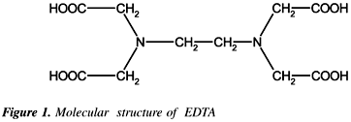
Determination of hardness of water by EDTA method
Hardness of water can be readily determined by titration with the chelating agent EDTA.
EDTA is ethylene diamine tetra acetic acid. It is a weak acid that can lose four H+ ions on complete neutralization. Its formula is

Slide 34
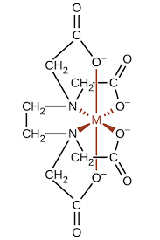
M-EDTA Complex structure: Stable at pH=10 Octahedral complex

Slide 35
Theory or Principle:
The process involves the titration of metal ion solution with standardized EDTA soln. Indicator used is Eriochrome Black-T (EBT).
EBT is alcoholic solution of blue eye. It forms an unstable wine-red complex with Ca2+ & Mg2+ at pH =10. A buffer solution of NH4OH & NH4Cl is used to maintain the pH = 10.
Initial reaction: When EBT indicator is added to hard water buffered to pH =10, a wine red unstable complex is formed. pH = 10
M²⁺ + EBT → [M-EBT] complex (Unstable)
(Wine red)
Titration Reaction: During the course of titration with EDTA soln, EDTA combines with M2+ ions to form stable complex M-EDTA & releases free EBT indicator, which immediately combines with remaining M2+ ions present in solution. Thus wine red colour retained.
[M-EBT] complex + EDTA → [M-EDTA] complex + EBT
pH = 10
M²⁺ + EBT → [M-EBT] complex
End point Reaction: At end point all of the cations formed M-EDTA complex, where last drop of EDTA added displaces the EBT indicator from M_EBT complex and wine red colour changes to blue due to presence of only free EBT. Thus the colour change is wine red to blue at the end point of titration.
pH = 10
[M-EBT] complex + EDTA → [M-EDTA] complex + EBT
Colour change : Wine red to Blue
Practical Colour change: Wine red to purple to blue

Slide 36
Experimental Procedure:
Preparations of solutions
Preparation of Standard Hard water (SHW):
Dissolve 1g of CaCO3 in minimum amount of dil. HCl till all solid dissolves and evaporated to dryness. Dissolve this residue in 1L distilled water. Each mL of this solution contains 1mg of CaCO3 equivalent hardness.
1g of CaCO3 in 1L of water= 1000mg of CaCO3 in 1L = 1000ppm soln
1mL of SHW (CaCO3) soln = 1mg of CaCO3
100mL of SHW = _100__mg of CaCO3
1ppm = 1mg/L
ii) Preparation of EDTA solution: Dissolve 3.72g of pure EDTA + 0.1 mg MgCl2 in 1L of distilled water.
iii) Preparation of indicator: dissolve 0.5g of EBT indicator in 100ml of alcohol.
iv) Preparation of Buffer soln: Add 67.5g of NH4Cl to 570mL of ammonia soln and then dilute with distilled water to 1L.

Slide 37
B) Procedure: it has three steps:
Step 1: Standardization of Hard water: Pipette out 50mL of SHW in a conical flask. Add 10mL of buffer soln and 4 to 5 drops of EBT indicator. Titrate with EDTA soln till wine red colour changes to blue. Let the volume used be V1 mL.
50mL of SHW = V1 mL of EDTA
1ml of EDTA = ___mg of CaCO3
Step 2: Titration of unknown hard (bore well) water: Titrate 50mL of sample water just same as given instep 1. Let the volume used be V2 mL.
50mL of sample HW = V2 mL of EDTA
Total Hardness
Step 3: Titration of permanent hardness: Take 50mL of water sample in a beaker and boil it till volume reduces to half. (where all bicarbonates are decomposed to insoluble CaCO3 and Mg(OH)2.) Filter the solution and titrate the filtrate as given in step 1. Let the volume used be V3 mL.
50ml of boiled sample HW = V3 mL of EDTA
Permanent Hardness

Slide 38
Calculations:
50ml of SHW = V1 mL of EDTA soln
Since 1 mL SHW contains 1mg of CaCO3,
50mg of CaCO3 = V1 mL of ETDA soln.
Hence, 1mL of EDTA = 50/V1 mg of CaCO3 eq.
Total Hardness
50mL of sample hard water = V2 mL of EDTA soln
= V2 x 50/V1 mg of CaCO3 eq.
Hence 1000mL of sample hard water = 1000 V2x 50/V1 x 1/50 mg of CaCO3 eq.
there fore, Total Hardness = V2/V1 x 1000 ppm
B) Permanent Hardness:
Now, 50ml of boiled sample water = V3 mL of EDTA
= V3 x 50/V1 mg of CaCO3
Hence 1000mL of Sample hard water = V3/V1 x 1000 mg of CaCO3
Therefore, Permanent hardness = V3/V1 x 1000 ppm
C) Temporary hardness = Total hardness – Permanent hardness

Slide 39
Advantages of EDTA method
This method is preferable to the other methods, because of
Greater accuracy
Convenience
More rapid procedure

Slide 40
Numerical 1: 50mL of standard hard water requires 38mL of EDTA solution. 100 mL of water sample consumes 21mL of EDTA soln. 100mL of boiled water sample consumes 10mL of EDTA soln. Find all types of hardness.
Solution:
50 mL of SHW = _50_mg of CaCO3
50mL of SHW = 38 ml of EDTA soln.
There fore, 38mL of EDTA = 50mg of CaCO3
1mL of EDTA = _50/38__mg of CaCO3
1mL of EDTA = 1.316mg of CaCO3
Total Hardness:
100mL of sample HW =21 mL of EDTA solution
= 21 x 1.316 mg of CaCO3
= 27.636 mg of CaCO3
1000mL of sample HW = 27.636 x 1000/100
= 276.36mg of CaCO3/L = 276.36ppm
There fore Total hardness = 276.36ppm
Permanent hardness:
100mL of Boiled sample HW = 10mL of EDTA
= 13.16 mg of CaCO3
1000mL of boiled sample HW = 13.16 x 1000/100 = 131.6mg of CaCO3 / L
Permanent hardness = 131.6ppm
Temporary Hardness = Total hardness – permanent hardness
= 276.36 – 131.6
= 144.76ppm

Slide 41
Numerical 2: 50 mL of Standard hard water required 21mL of EDTA solution. 50mL of sample Water requires 21mL of EDTA solution. 50mL of boiled sample water requires 7mL of EDTA soln. calculate all the types of hardness.
Soln:
50mL of SHW = 50mg of CaCO3
50mL of SHW = 21mL of EDTA
There fore 21 mL of EDTA soln = 50mg of CaCO3
Hence 1mL of EDTA soln = 50/21 = 2.381mg of CaCO3 eq.
Total Hardness
50mL of sample HW = 21mL of EDTA soln
= 21 x 2.381 = 50.001 mg of CaCO3 eq.
1000mL of sample HW = 50.001 x 1000/50 = 50.001 x 20
= 1000.02mg CaCO3/L
Hence Total hardness = 1000.02ppm
Permanent Hardness
50mL of boiled sample HW = 7mL of EDTA soln
= 7 x 2.381 = 16.667mg of CaCO3/L
1000mL of boiled sample HW = 16.667 x 1000/50 = 16.667 x 20 =333.34mg of CaCO3
Hence permanent hardness = 333.34ppm
Temporary Hardness = total hardness – permanent hardness = 1000.02 -333.34 = 666.68 ppm

Slide 42
Numerical 3: 0.38g of CaCO3 was dissolved in HCl and the solution made up to 1Litre with distilled water. 100 mL of the above soln required 25mL of EDTA soln. 100 mL of hard water sample required 37mL of EDTA soln. 100mL of boiled hard water sample required 10mL of EDTA soln. Calculate each type of hardness.
Soln
1ml of SHW = 1mg of CACO3
SHW = 0.38g of CaCO3/ 1000mL = 380mg of CaCO3 / 1000mL
1mL of SHW = 0.38mg of CaCO3……using 1st statement of numerical
100mL of SHW = 25mL of EDTA
100mL of SHW = 38 mg of CaCO3
There fore 25mL of EDTA = 38mg of CaCO3
Hence 1mL of EDTA = 38/25 =1.52mg of CaCO3 ……using 2nd statement of numerical
Total Hardness
100mL of sample HW = 37mL of EDTA
= 37 x 1.52 = 56.24 mg of CaCO3
1000ml of sample HW = 56.24 x 1000/100 = 562.4 mg of CaCO3 /L
Hence Total hardness = 562.4ppm
Permanent hardness
100mL of Boiled sample HW = 10 ml of EDTA
= 10 x 1.52 = 15.2 mg of CaCO3
1000mL of Boiled sample HW = 15.2 x 1000/100 = 152 mg of CaCO3
Hence permanent hardness = 152ppm
Temporary Hardness = total Hardness – permanent hardness = 562.4-152 = 410.4ppm

Slide 43
Numerical 4: 1.2g of CaCO3 was dissolved in HCl and the solution made up to 1Litre with distilled water. 50 mL of the above soln required 30 of EDTA soln. 100 mL of hard water sample required 27mL of EDTA soln. 100mL of boiled hard water sample required 11mL of EDTA soln. Calculate each type of hardness.
Soln:
Numerical 5: 0.55g of CaCO3 was dissolved in HCl and the solution made up to 1Litre with distilled water. 20 mL of the above soln required 10 of EDTA soln. 50 mL of hard water sample required 17mL of EDTA soln. 10mL of boiled hard water sample required 1.1mL of EDTA soln. Calculate each type of hardness.
Ans: Total Hardness = 374ppm
permanent Hardness = 121ppm
Temporary Hardness = 253
Numerical 6: 50mL sample of water require 10.2mL of M/20 disodium EDTA for titration. After boiling and filtration the same volume required 6.5mL of EDTA. Calculate all the types of hardness in it.

Slide 44
Numerical 6: 50mL sample of water require 10.2mL of M/20 disodium EDTA for titration. After boiling and filtration the same volume required 6.5mL of EDTA. Calculate all the types of hardness in it.
Soln:
1mL of 0.05M EDTA = ___mg of CaCO3
M/20 EDTA = 1/20M EDTA = 0.05M EDTA
Std relationships says that,
1000mL of 1M EDTA = 100g of CaCO3……due to Avogadro's numbers of molecules
1mL of 1M EDTA = 100mg of CaCO3
1mL of 0.05M EDTA = 100 x 0.05 = 5mg of CaCO3
Total Hardness:
50 mL of sample HW = 10.2mL of 0.05M EDTA soln
= 10.2 x 5 =51mg of CaCO3 eq.
1000mL of sample HW = 51 x 1000/50 = 51 x 20 = 1020mg of CaCO3
Hence Total Hardness = 1020ppm
Permanent Hardness:
50mL of Boiled sample HW = 6.5mL of 0.05M EDTA
= 6.5 x 5 = 32.5mg of CaCO3 eq.
1000mL of boiled Sample HW = 32.5 x 20 = 650mg of CaCO3 eq
Hence Permanent Hardness = 650ppm
So, temporary hardness = 1020-650 = 370ppm

Slide 45
Numerical 7: 50mL sample of water require 15.3mL of M/15 disodium EDTA for titration. After boiling and filtration the same volume required 9.5mL of EDTA. Calculate all the types of hardness in it.
Solution
M/15 EDTA = 1/15M EDTA = 0.067M EDTA
Std relationships says that,
1000mL of 1M EDTA = 100g of CaCO3……due to Avogadro's numbers of molecules
1mL of 1M EDTA = 100mg of CaCO3
1mL of 0.067M EDTA = 100 x 0.067 = 6.7mg of CaCO3
Total Hardness:
50 mL of sample HW = 15.3mL of 0.067M EDTA soln
= 15.3 x 6.7 =102.51mg of CaCO3 eq.
1000mL of sample HW = 102.51 x 1000/50 = 102.51 x 20 = 2050.2 mg of CaCO3
Hence Total Hardness = 2050.2ppm
Permanent Hardness:
50mL of Boiled sample HW = 9.5mL of 0.067M EDTA
= 9.5 x 6.7 = 63.65mg of CaCO3 eq.
1000mL of boiled Sample HW = 63.65 x 20 = 1273mg of CaCO3 eq
Hence Permanent Hardness = 1273ppm
So, temporary hardness = 2050.2-1273= 777.2ppm

Slide 46
Softening of Water by Lime-Soda Method
The process of removing or reducing the concentrations of hardness causing ions/ salts from hard water is called as Softening of water.
Principle
In this method hard water is treated with calculated amounts of slaked Lime[Ca(OH)2] and soda ash Na2CO3 in reactions tanks. So as to convert hardness producing chemicals into insoluble compounds, which are then removed by settling and filtration.

Slide 47
Convert Ca2+ in CaCO3 and Mg2+ into Mg(OH)2, Fe 2+ → Fe(OH)2
Soda = Na2CO3 and Lime = Ca(OH)2
Constituent | Reactions | Requirement L or S
Ca2+ (perm.) Eg. CaCl2, CaSO4 | Ca2+ + Na2CO3 → CaCO3 + 2Na+ | S
2) Mg2+ (perm.) Eg. MgCl2, MgSO4 | Mg2+ + Ca(OH)2 → Mg(OH)2 + Ca2+ Ca2+ + Na2CO3 → CaCO3 + 2Na+ | L + S
3) HCO3- Eg. NaHCO3 | 2HCO3- + Ca(OH)2 → CaCO3 + 2H2O + CO3²⁻ = Na2CO3 | L – S
4) Ca(HCO3)2 Temp. | Ca(HCO3)2 + Ca(OH)2 → 2CaCO3 + 2H2O | L
5) Mg(HCO3)2 Temp. | Mg(HCO3)2 + 2Ca(OH)2 → Mg(OH)2 + 2 CaCO3 + 2H2O | 2L
6) CO2 | CO2 + Ca(OH)2 → CaCO3 + H2O | L
7) H+ | 2H+ + Ca(OH)2 → 2H2O + Ca2+ Ca2+ + Na2CO3 → CaCO3 + 2Na+ | L + S
8) FeSO4 | FeSO4 + Ca(OH)2 → Fe(OH)2 + CaSO4 Fe(OH)2 + O2 + H2O → Fe(OH)3 CaSO4 + Na2CO3 → CaCO3 + Na2SO4 | L+S

Slide 48
Constituent | Reactions | Requirement L or S
9) Al2(SO4)3 | 2Al3+ + 3 Ca(OH)2 → 2Al(OH)3 + 3Ca2+ 3Ca2+ + 3Na2CO3 → 3CaCO3 + 6Na+ | L + S
10) NaAlO2 | NaAlO2 + H2O → Al(OH)3 + NaOH | -L
Equivalence
CaCO3 = Ca(OH)2 = Na2CO3
100 = 74 = 106
Lime required = 74/100 [ Mg2+ perm. + HCO3- + Ca2+ temp. + 2 Mg2+ temp. + CO2 + H+ + Fe2+ + Al3+ -NaAlO2] mg/L
= 74 [ Mg2+ perm. + HCO3- + Ca2+ temp. + 2 Mg2+ temp. + CO2 + H+ + Fe2+ + Al3+ -NaAlO2] x Volume of water x 100
100 x 1000 x % Purity
= g of Lime
Soda required = 106 [ Ca2+ perm. + Mg2+ perm – HCO3- + H+ + Fe2+ + Al3+] x volume of water x 100
100 x 1000 x % purity
= ___g of Soda

Slide 49
Numerical 1: Calculate the amount of lime (74% pure) & Soda (90% Pure) for softening of 6000 litres of water containing following impurities.
Mg(HCO3)2 =73mg/L, CaCl2 = 222mg/L, MgSO4 = 120mg/L, Ca(NO3)2 = 164mg/L.
Soln
Impurities | Multiplication Factor | CaCO3 eq. | Requirement
Mg(HCO3)2 = 73mg/L | 100/ 146 or 50/73 | = 73 x 50/73 =50 | 2L
2) CaCl2 = 222mg/L | 100/111 or 50/55.5 | 222 x 100/111 = 200 | S
3) MgSO4 = 120mg/L | 100/120 or 50/60 | 120 x 100/120 = 100 | L + S
4) Ca(NO3)2 = 164mg/L | 100/164 or 50/82 | 164x 100/164 = 100 | S
Lime required = 74 x [CaCo3 eq of 2x Mg(HCO3)2 + MgSO4] x volume of water x 100
100 x 1000 x % purity
= 74 x [ 2 x 50+ 100] x 6000 x 100 = 200 x 6 = 1200g = 1.2Kg
100 x 1000 x 74
Soda Required = 106 x [ CaCO3 eq of CaCl2 + MgSO4 + Ca(NO3)2 ] x vol. of water x 100
100 x 1000 x % purity
= 106 x [ 200+100+100] x 6000 x 100 = 2826.67g = 2.827Kg
100 x 1000 x 90

Slide 50
Numerical 2: Calculate the quantity of soda and lime needed to soften 10000 litres of water containing following impurities. Na2SO4 =7mg/L, SiO2 = 2mg/L, CaCl2 = 22.2mg/L, MgSO4 = 2.0mg/L, Mg(HCO3)2 = 5.0mg/L.
Soln:
Lime Required = 74 x [CaCo3 eq of MgSO4 + 2x Mg(HCO3)2 x 10000
100 x 1000
= 74 x [1.67 + 3.42x2] x 10000 = 62.974g
100 x 1000
Soda Required = 106 x [CaCo3 eq. of CaCl2 + MgSO4] x vol of water
100 x 1000
= 229.702g
Impurities | Multiplication Factor | CaCO3 eq. | Requirement
1) Na2SO4 = 7mg/L | Non-hardness causing
2) SiO2= 2mg/L | Non-hardness causing
3) CaCl2 = 22.2mg/L | 100/111 or 50/55.5 | = 22.2 x 100/111 =20 | S
4) MgSO4 =2.0mg/L | 100/120 or 50/60 | = 2 x 100/120 =1.67 | L + S
5) Mg(HCO3)2 = 5.0mg/L | 100/146 or 50/73 | = 5.0 x 100/146 = 3.42 | 2L

Slide 51
Numerical 2: Calculate the quantity of soda and lime needed to soften 10000 litres of water containing following impurities. Na2SO4 =7mg/L, SiO2 = 2mg/L, CaCl2 = 22.2mg/L, MgSO4 = 2.0mg/L, Mg(HCO3)2 = 5.0mg/L.

Slide 52
Numerical 3: Calculate amount of lime (90% pure) and Soda (98% Pure)for the treatment of 1 million litres ofwater containing Ca(HCO3)2 = 8.1ppm, CaCl2=33.3ppm, HCO3-= 91.5ppm, MgCl2 = 38ppm, Mg(HCO3)2 = 14.6ppm. The coagulant Al2(SO4)3 was added at the rate of 17.1ppm.
Lime Required = 74 x { Caco3 eq of Ca(HCO3)2+HCO3-+MgCl2 +2xMg(HCO3)2+Al2(SO4)3}x volume of water x 100
100 x 1000x 90
= 74 [5+75+40+20+15]x 1000000 x 100
100 x 1000 x 90
=127444.44g = 127.44Kg
Soda required = 10816.33g = 10.816Kg
Impurities | Multiplication Factor | CaCO3 eq. | Requirement
Ca(HCO3)2 = 8.1mg/L | = 100/162 or 50/81 | 5 | L
2) CaCl2 = 33.3mg/L | 100/111 or 50/55.5 | 30 | S
3) HCO3- = 91.5mg/L | =100/122 or 50/61 | 75 | L - S
4) MgCl2 =38.0mg/L | 100/95 or 50/47.5 | 40 | L + S
5) Mg(HCO3)2 = 14.6mg/L | 100/146 or 50/73 | 10 | 2L
6) Al2(SO4)3 = 17.1mg/L | 100/114 or 50/57 | 15 | L + S

Slide 53
Numerical 3: Calculate amount of lime (85% pure) and Soda (92% Pure)for the treatment of 1 million litres ofwater containing Ca(HCO3)2 = 16.2ppm, CaCl2=22.2 ppm, HCO3-= 61 ppm, MgCl2 = 47.5ppm, Mg(HCO3)2 = 14.6ppm. The coagulant Al2(SO4)3 was added at the rate of 20 ppm.
Impurities | Multiplication Factor | CaCO3 eq. | Requirement
Ca(HCO3)2 = 16.2mg/L | = 100/162 or 50/81 | 10 | L
2) CaCl2 = 22.2mg/L | 100/111 or 50/55.5 | 20 | S
3) HCO3- = 61mg/L | =100/122 or 50/61 | 50 | L - S
4) MgCl2 =47.5mg/L | 100/95 or 50/47.5 | 50 | L + S
5) Mg(HCO3)2 = 14.6mg/L | 100/146 or 50/73 | 10 | 2L
6) Al2(SO4)3 = 20mg/L | 100/114 or 50/57 | 17.544 | L + S
Lime Required = 74 x [CaCo3 eq of MgCl2 + Ca(HCO3)2+ HCO3+Al2(SO4)3 + 2x Mg(HCO3)2 x 1000000 x 100
100 x 1000 x 85
= 74 x [10+50+50+20+17.544] x 1000000 x100 = 128450.070g = 128.45KG
100 x 1000 x85
Soda Required = 106 x [CaCo3 eq. of CaCl2- HCO3+ Al2(SO4)3 + MgCl2] x 1000000x 100
100 x 1000 x 92
= 43257.217g = 43.257Kg

Slide 54
Numerical 3: Calculate amount of lime (90% pure) and Soda (98% Pure)for the treatment of 1 million litres ofwater containing Ca(HCO3)2 = 8.1ppm, CaCl2=33.3ppm, HCO3-= 91.5ppm, MgCl2 = 38ppm, Mg(HCO3)2 = 14.6ppm. The coagulant Al2(SO4)3 was added at the rate of 17.1ppm.

Slide 55
Types of Lime Soda Processes
Hot Lime-Soda Method
Cold Lime-Soda Method

Slide 56
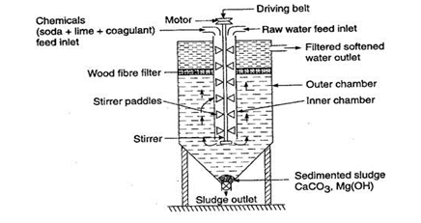
Cold Lime Soda Method
Principle:
In this process calculated quantities of lime and soda are mixed
with hard water at room temperature.
The precipitate formed are finely divided and there fore
do not settle down easily and cant be filtered easily.
Thus it is essential to add small quantities of coagulants like
alum, aluminum sulphate, sodium aluminates.
These hydrolyze to gelatinous ppt of aluminum hydroxide and
entrap fine precipitate.
If sodium aluminate is used as coagulant, silica as well as oil
present in water are also removed.
Cold lime soda process provides water containing a
Residual hardness of 50 to 60 ppm.
NaAlO2 + 2H2O → NaOH + Al(OH)3
Al2(SO4)3 + 3Ca(HCO3)2 → 2Al(OH)3 + 3CaSO4 + 6CO2

Slide 57
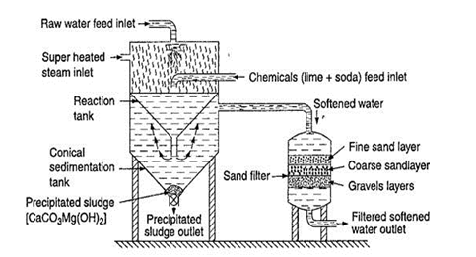
Hot Lime Soda Method
Principle:
In this method water is treated with softening chemicals like soda and Lime at a temp. of 80°C to 150°C. this process is operated at a temp close to boiling point of the solution.
Hence the reaction proceeds faster, the softening capacity
Of the process increased many fold, the precipitate and sludge formed settle down rapidly and hence no coagulants are required.
Much of the dissolved gases like CO2 & air are driven out of water.
Viscosity of soften water is lowered therefore filtration of water becomes much easier.
This method produces water of comparatively lower
residual hardness of 15 to 30 ppm.

Slide 58
Advantages of Lime Soda Process
It is very Economical
If the process is combined with sedimentation & coagulation, lesser amounts of coagulants shall be needed.
The process increases the pH value of the treated water, thereby corrosion of the distribution pipe is reduced.
Besides the removal of hardness, the quantity of minerals in the water is reduced.
To a certain extent, iron and manganese are also removed from the water.
Due to alkaline nature of treated water, the amount of pathogenic bacterial in water is considerably reduced.

Slide 59
Disadvantages
For efficient and economical softening, careful operation & skilled supervision is required.
Disposal of large amounts of sludge poses a problem. However the sludge may be disposed off in raising low lying areas of the city.
This can remove hardness only up to 15ppm which is not good for boilers.

Slide 60
Softening of water by zeolite process
Sodium zeolite: Na2O. Al2O3.xSiO2.yH2O
Where x = 2-10 and y = 2-6
Zeolite is sodium alumino silicate capable of exchanging reversibly its sodium ions for hardness producing ions present in water.
Types of zeolite
Natural Zeolite: are non porous eg. Natrolite Na2O.Al2O3.4SiO2.2H2O
Synthetic Zeolite: are porous and possess gel structure. They are prepared by heating together china clay, feldspar and soda ash.

Slide 61
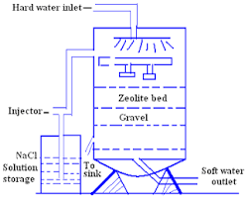
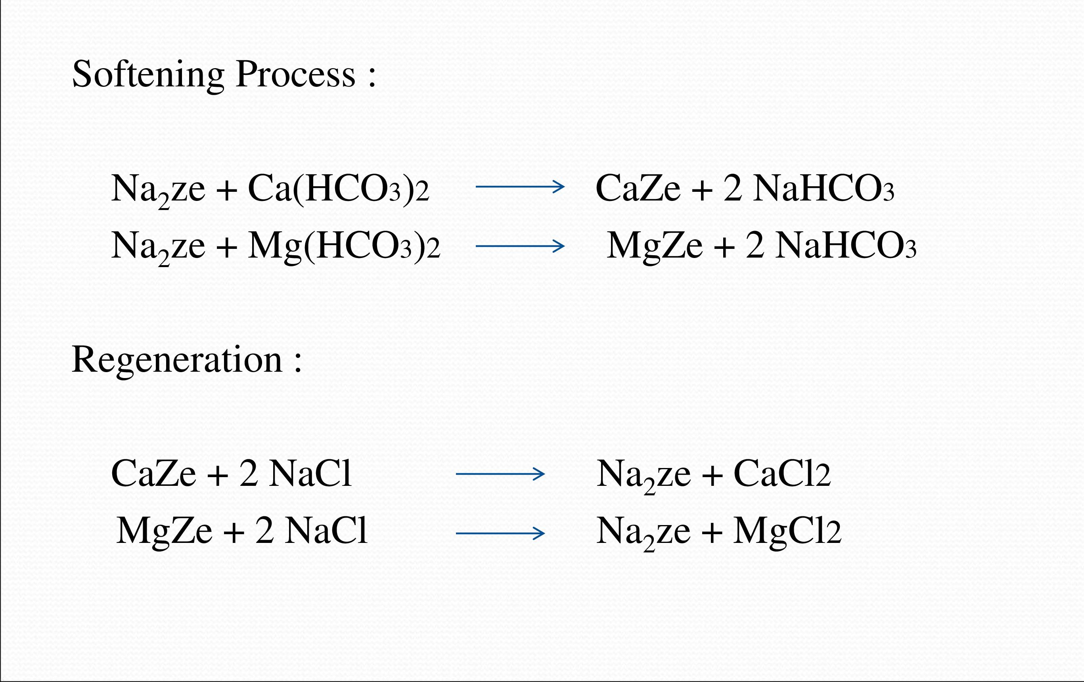

Slide 62
Advantages of zeolite process
It removes the hardness almost completely and water of about 10ppm hardness is produced.
The equipment used is compact, occupying small space.
No impurities are precipitated, so there is no danger of sludge formation in treated water at a later stage.
The process automatically adjusts itself for variation in hardness of incoming water.
It is quite clean process.
It requires less time for softening.
It requires less skill for maintenance as well as operation.

Slide 63
Disadvantages
The treated water contains more sodium salts than in lime soda process.
The method only replaces Ca2+ and Mg2+ ions by Na+ ions but leaves all the acidic ions like HCO₃- and CO₃2- as such in the softened water.
When such soften water is used in boilers for steam generation, sodium carbonate decomposes producing CO2, which cause corrosion and sodium carbonate hydrolyses to sodium hydroxide which cause caustic embrittlement.
High turbidity water cannot be treated efficiently by this method.

Slide 64
Numerical 1: The hardness of 10000 litres of hard water sample was completely removed by passing it through a zeolite softener. The zeolite softener required 5000litres of NaCl soln containing 1170mg of NaCl/L. Determine hardness of water sample.
Solution:
5000 L of NaCl soln = 5000 x 1170mg of NaCl
= 5850000mg of NaCl
1eq of NaCl = 1eq of CaCO3
58.5mg of NaCl = 50mg of CaCO3
5850000mg of NaCl = 5000000 mg of CaCO3
There fore,
10000L of Hard water = 5000000mg of CaCO3
1L of Hard water = 5000000/10000 = 500mg of CaCO3
Hence Hardness of water = 500ppm.

Slide 65
Numerical 2: An Exhausted zeolite softener was regenerated by passing 75L of NaCl soln having strength of 75g/L. If 1.6 x 10⁴ hard water was passed though zeolite bed, what will be the hardness of water.
^{Soln:}
75L of NaCl = 75 x 75 g of NaCl = 5625g of NaCl
= 5625 x 10³ mg of NaCl
1eq of NaCl = 1eq. Of CaCO3
58.5mg of NaCl = 50mg of CaCO3
5625x10³ mg of NaCl = 5625 x 10³ x 50/58.5 mg of CaCO₃
= 4.81 x 10⁶ mg of CaCO₃
1.6 x 10⁴ L of hard water = 4.81 x 10⁶ mg of CaCO3
1L of hard water = 4.81 x 10⁶ / 1.6 x 10⁴
= 300ppm

Slide 66
Numerical 3: An exhausted zeolite softener was regenerated by passing 125L of NaCl having strength 50gNaCl/L. If the hardness of water is 350ppm, then calculate the total volume of water sample.
Soln:
125L of NaCl = 125 x 50g of NaCl
= 6250g = 6250000mg of NaCl
58.5mg of NaCl = 50mg of CaCO3
6250000mf of NaCl = 6250000x50/58.5
= 5341880mg of CaCO3
1L of hard water = 350mg of CaCO3
Therefore,
x L of Hard water = 5341880mg of CaCO3
Hence volume of hard water = 5341880/350
= 15262.5L

Slide 67
Numerical4: Calculate the volume of NaCl (12.5g/L) in L for regeneration of zeolite, the 200ppm of 10000L of hardwater was passed through it to get zeolite exhausted.

Slide 68
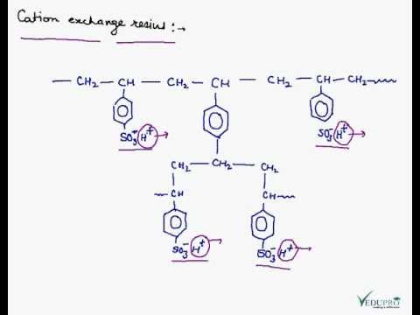
Softening of Water by Ion-Exchange Process Or Demineralization process
Ion exchange resins are insoluble cross linked long-chained organic polymers with a microporous structure.
Cation Exchange resin: Styrene-divinyl benzene copolymers which on sulphonation or carboxylation become capable of exchanging their hydrogen ions with the cations in hard water.

Slide 69
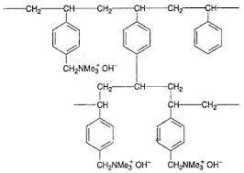
Anion Exchange resin: Styrene-divinyl benzene copolymers which on further functionalization like formylation followed by Mannich reaction or nitration followed by amination and alkylation gives quaternary ammonium groups as an integral part of the resin matrix. These after treatment with dil NaOH soln become capable of exchanging their OH- anions with anions of hard water.

Slide 70
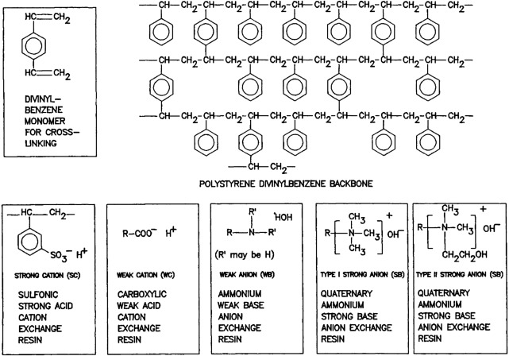

Slide 71
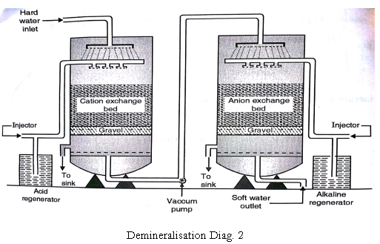
Process: Ca(HCO3)2, CaCl2, MgCl2

Slide 72
Reactions with Cation Exchanger: RH+
RH+ + Ca2+ → R₂Ca + 2H+
Resin Hardwater Resin Soften water
RH+ + Mg2+ → R2Mg + 2H+
HCO3-, Cl-, SO4-
Reactions with Anion Exchanger: R’OH
R’OH + Cl- → R’Cl + OH-
Resin Hard Water Resin Soften water
2R’OH + SO4- → R’2SO4 + 2OH-
Overall Reaction:
H+ + OH- → H2O
Regeneration Reactions
Cation Exchanger
R₂Ca + 2HCl → RH+ + CaCl2
Regenerated Resin Washings
Anion Exchanger
R’₂SO₄ + 2NaOH → 2 R’OH + Na₂SO₄

Slide 73
Advantages
The process can be used to soften highly acidic or alkaline water.
It produces water of very low residual hardness (2ppm) so it is very good for treating water for use in high pressure boilers.
Disadvantages:
The Equipment is costly and more expensive chemicals are needed.
If water contains turbidity then the output of the process is reduced. The turbidity must be below 10ppm. If it is more it has to be removed first by coagulation and filtration.

Slide 74
Numerical 1: After treating 10000 litres of water by ion exchanger the cationic resin required 200 litres of 0.1N HCl and anionic resin required 200 Litres of 0.1N NaOH soln. Find the hardness of water.
Soln:
Hardness of 10000L of water = 200 L of 0.1N HCl
= 200L of 0.1 N NaOH
1 eq. of HCl = 1 Eq. of CaCO3
0.1N of HCl = 0.1N of CaCO3
Hence,
Hardness of 10000L of water = 200L of 0.1N CaCO3 eq.
= 20L of 1N CaCO3 eq.
Std Statement: 1L of 1N CaCO3 = Eq. wt = 50g
Hardness of 10000L of water = 20 x 1L of 1N CaCO3
= 20 x 50 g = 1000g
= 1000000mg of CaCO3 eq.
Hence,
Hardness of 1L of water = 1000000/10000 = 100mg/L = 100ppm

Slide 75
Numerical 2: After treating 50000 litres of water by ion exchanger the cationic resin required 150 litres of 0.25N HCl and anionic resin required 150 Litres of 0.25N NaOH soln. Find the hardness of water.

Slide 76
BOD:
Biological oxygen demand of sewage is defined as the amount of free oxygen required for the biological oxidation of the organic matter under aerobic condition at 20°C for a period of 5days.
Unit of BOD = ppm or mg/L
Determination of BOD
A known volume of effluent sample is diluted with a known volume of water. Sample is diluted to ensure that sufficient oxygen is available for the complete aerobic oxidation of organic matter.
The diluted sample is divided into two parts and kept in two stoppered bottles. The dissolved oxygen content of one of the bottle is determined by Winkler's method, which is blank reading. It is denoted as DO_{b} .
Another bottle is incubated at 20°C for 5days. Then dissolved oxygen is determined. This is denoted as DOi.
The difference between DOb and DOi gives BOD.
BOD = (DOb-DOi) x dilution factor
= (DOb-DOi) x Volume of sample after dilution/volume of sample before dilution.

Slide 77
BOD test is usually influenced by the type of micro-organisms, presence of toxins, pH, Some reduced minerals; etc.
Reaction:
Organic Matter + O2 → CO2 + H2O
BOD is proportional to the amount of organic waste to be degraded.
An average sewage has BOD of 100-150ppm.
Drinking water should have BOD less than 1ppm.
Significance of BOD:
It indicates the amount of decomposable organic matter in sewage.
The higher is the BOD of a sample the higher the amount of decomposable organic matter in the sample and the higher is the pollution in water.
From BOD self purifying capacity of streams cans be determined. Thus it provides the degree of pollution at any time in the sewage stream.

Slide 78
COD
Chemical oxygen demand may be defined as the amount of oxygen required for the oxidation of chemically degradable organic matter in the hot conditions with the use of oxidants like acidified K2Cr2O7 in 2-3hrs.
Unit of COD = mg/L or ppm
Determination of COD:
A known volume of waste water sample is refluxed with a known excess of standard potassium dichromate soln and dilute sulphuric acid in presence of silver sulphate for 2-3hs. Silver sulfate is used as catalyst to promote oxidation of straight chain aliphatic compounds, aromatic compounds.
The organic matter of the sample is oxidized to ammonia, CO2 and H2O. The unreacted K2Cr2O7 is titrated against Ferrous ammonium sulphate[FeSo4.(NH4)2SO4.H2O]i.e. Mohr’s Salt.
This experimentally measured amount of potassium dichromate is used to calculate the equivalent oxygen required by the waste water for degradation of the pollutants.

Slide 79
Reactions
CxHyOz + (x + y/4 –z/2) O2 → xCO2 + y/2 H2O
The unreacted dichromate solution is titrated against Mohrs salt using ferroin indicator.
Cr₂O₇²⁻ + 14H⁺ + 6e⁻ → 2Cr³⁺ + 7H₂O
[Fe²⁺ → Fe³⁺ + e] x 6
Overall reaction
Cr₂O₇²⁻ + 14H⁺ + 6 Fe²⁺ → 2Cr³⁺ + 7H₂O + 6Fe³⁺
The COD is calculated as
COD = (V1-V2) x N_{FAS} x 8000
Volume of sample
V1 = vol. of FAS in blank titration
V2 = vol. of FAS in back titration

Slide 80
Significance of COD
The COD value is not affected by the presence of toxins and other unfavaourable conditions for the growth of microorganisms.
It is taken as basis for calculation of efficiency of treatment plant.
It help in designing the water treatment plant.

Slide 81
Numerical 1: A 50mL of sample contains 840ppm of dissolved oxygen. After 5days the dissolved oxygen value becomes 230 ppm, after the dilution of sample to 80mL. Calculate the BOD.
Soln: BOD = (Dob-Doi) x Volume of sample after dilution/ vol of sample before dilution
BOD = (840-230) x 80/50 = 976ppm
Numerical 2: A 25mL of sewage water sample was refluxed with 10mL of 0.25N K2Cr2O7 soln in presence of dil.H2SO4, Ag2SO4 and HgSO4. The unreacted dichromate required 6.5ml of 0.1N FAS. 10mL of same K2Cr2O7 required 27mL of 0.1N FAS. Calculate COD.
Given: Volume of sample = 25mL
Blank titration reading (V1) = 27mL
Back titration reading (V2) = 6.5mL
COD= (V1-V2) x N(FAS) x 8000/Vol. of Sample
= (27-6.5) x 0.1 x 8000/25 = 656ppm
Numerical 3: A 30mL of sewage water sample was refluxed with 15mL of 0.25N K2Cr2O7 soln in presence of dil.H2SO4, Ag2SO4 and HgSO4. The unreacted dichromate required 14 ml of 0.05N FAS. 15mL of same K2Cr2O7 required 20mL of 0.1N FAS. Calculate COD.
Note: Covert one statement in to fixed normality.
Volume of sample = 30mL
Blank Titration reading (V1) = 20ml of 0.1N FAS = 40 mL of 0.05N FAS
Back Titration reading (V2) = 14mL of 0.05N FAS
COD = 346.667ppm

Slide 82
Sewage Treatment
A sewage is the liquid waste which includes human and house hold waste water, industrial waste ground waste and street, storm waste.
Before disposing off the sewage to river or sea, it has to be treated.
To prevent –pollution of water
-- Offensive odour in water
- the destruction of fish and other aquatic life
Sewage treatment by activated sludge process.
Sewage contains minerals and inorganic matter in suspension and in solution. It contains sometimes harmful living organisms. Hence it is better to treat sewage before releasing into the river, lake and sea.
It involves four steps
Preliminary treatment
Primary treatment’
Secondary or biological treatment: activated sludge method
Tertiary treatment

Slide 83
Preliminary Treatment
The main objective of preliminary treatment is the removal of gross solid i.e. large floating and suspended matter, oil etc. For removing inorganic matter, sewage is allowed to pass through bar screens and mesh screens. It is also called as screening of sewage.
2) Primary Treatment
For removing suspended matter efficiently and economically, sedimentation process is carried out.
The sewage is treated with certain chemicals like(alum, hydrated lime etc.) which form a floc that absorbs and entrains the suspended and colloidal particles present.

Slide 84
3) Secondary treatment or Biological treatment
It is essentially an aerobic oxidation which includes filtration and activated sludge process.
Filtration: in this process, sewage water is filtered through specially designed sprinkling filters so that aerobic conditions are maintained.
During this process carbon of the organic matter is converted to CO2 and nitrogen into NH3 and finally onto nitrites and nitrates.
Trickling filters are used for the biological oxidation of sewage. Sewage is delivered to the filters by means of rotating distributors. As the trickled sewage starts flowing downwards, the aerobic bacteria grow on the surface. The bacteria bring about the biological oxidation of organic matter of sewage. The treated water comes out from bottom.

Slide 85
ii) Activated sludge process
The sludge formed from previous oxidation process is known as activated sludge.
This process consists of mixing of sedimented sewage with proper quantity of activated sludge and the mixture is then agitated for 4-6hrs by blowing air.
Suspended dissolved organic matter is oxidized by aerobic oxidation, then affluent is sent to sedimentation tank, where sludge is deposited and clean water drawn off.
A part of sludge deposited is used for next oxidation batch and the remainder is either spread on land as fertile matter or used for biogas or dumped in sea.

Slide 86
4) Tertiary Treatment
It is applied to decrease the load of nitrogen and phosphorous compounds present in effluents.
It involves treatment of effluent with lime which reacts with phosphorous to form calcium phosphate.
Nitrogen stripping is carried out to remove ammonia gas.
Chlorination was carried out to kill the disease causing microorganisms present in sewage water.
The so treated water is finally discharged into the rivers or lakes.

